Slide 1
VR View – virtual reality for everyone
adviser: André Langer
referee: Lucien Berger

Slide 2
VR View
What is VR View?
How does it work?
Pictures for VR View
Videos for VR View
Devices made for VR View

Slide 3
What is VR View?
script by Google → spring 2016
embed 360° VR media (1) into websites/ apps
→ no need for special hardware → immersive for everyone
different systems: web, IOS (8+), android (4.4+)
hosting → client side display solution

Slide 4
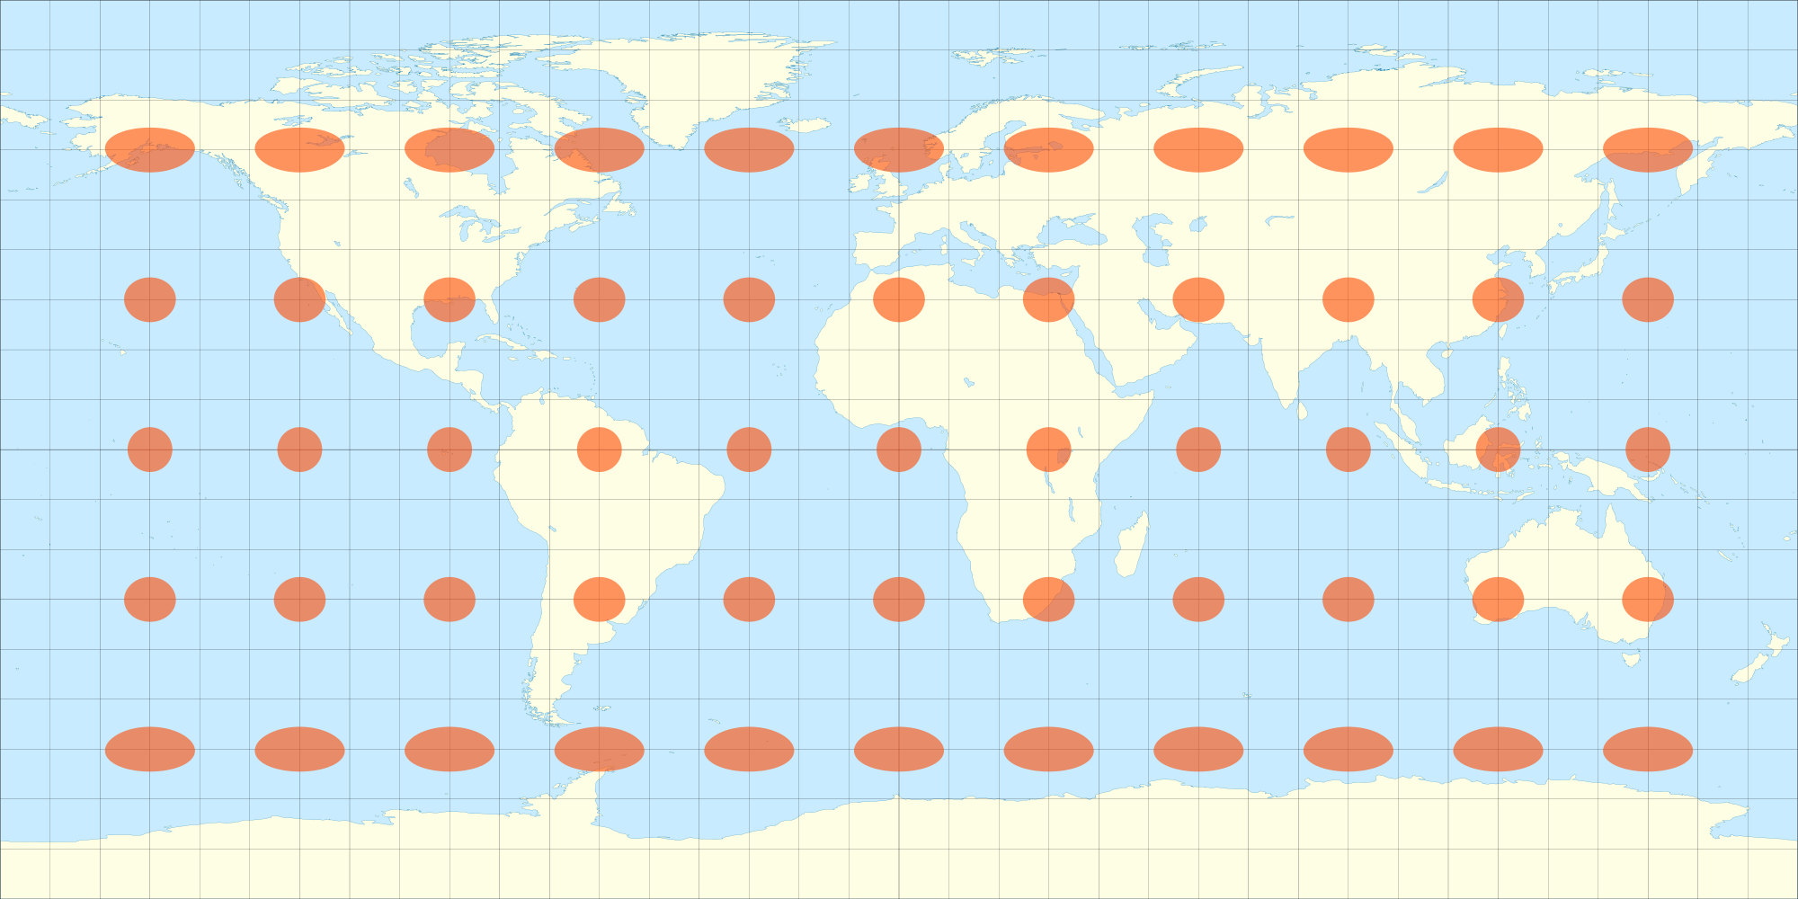
How does it work?
media = equirectangular projection
map to globe (2)
equirect pano

Slide 5
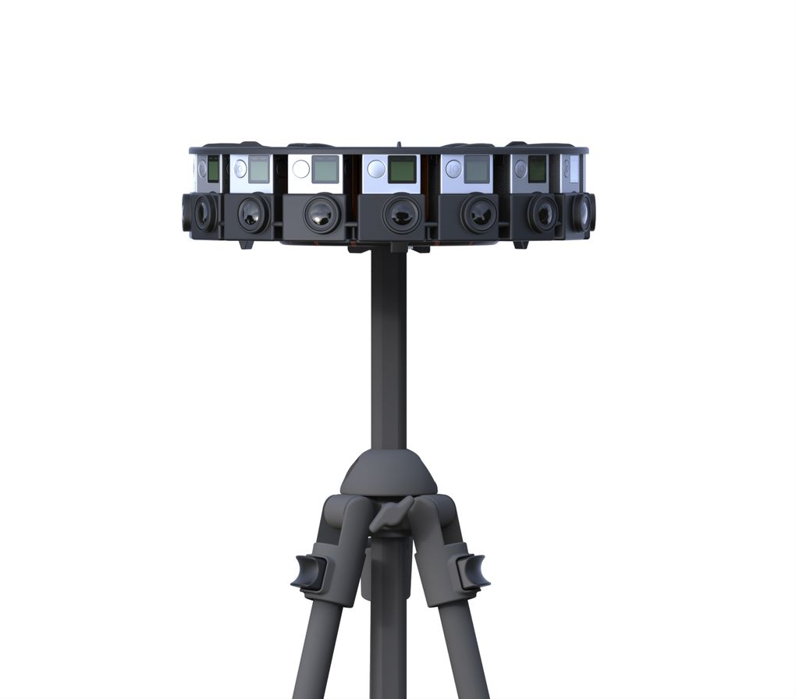
Pictures for VR View
captured in real life or a CGI
CGI: different plugins for Unity, Unreal, etc.
format: png, jpeg, gif
resolution: mono, 2:1 ratio, 4096x2048
stereo, 1:1 ratio, 4096x4096
camera installation: inside out<->outside in
(3)

Slide 6
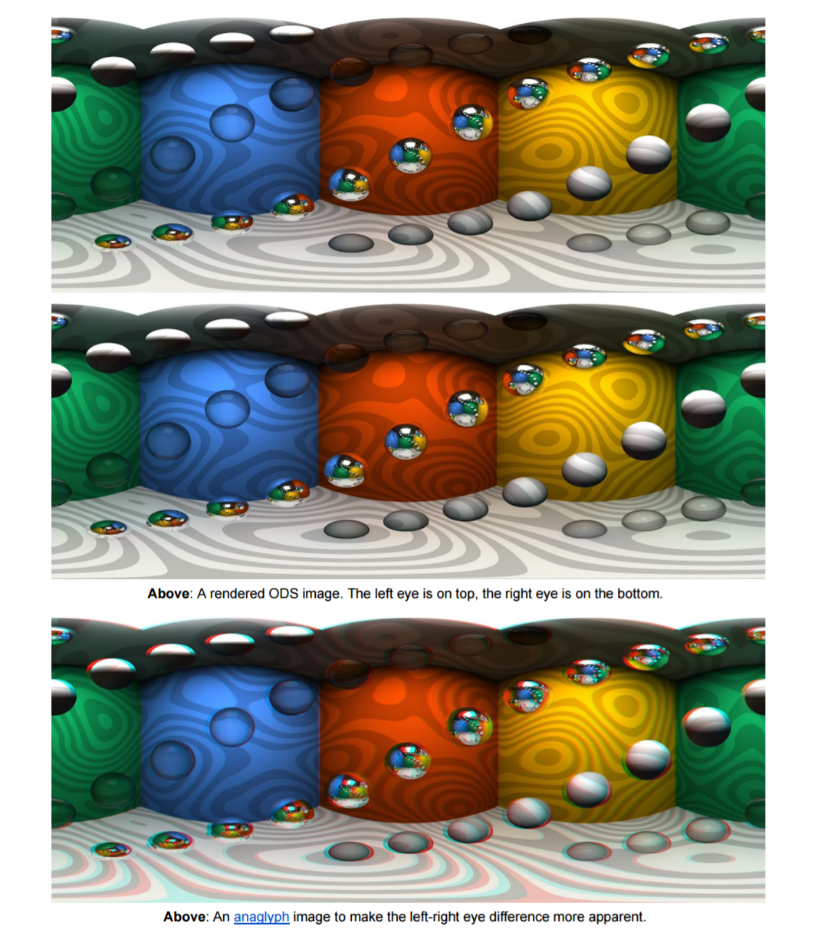
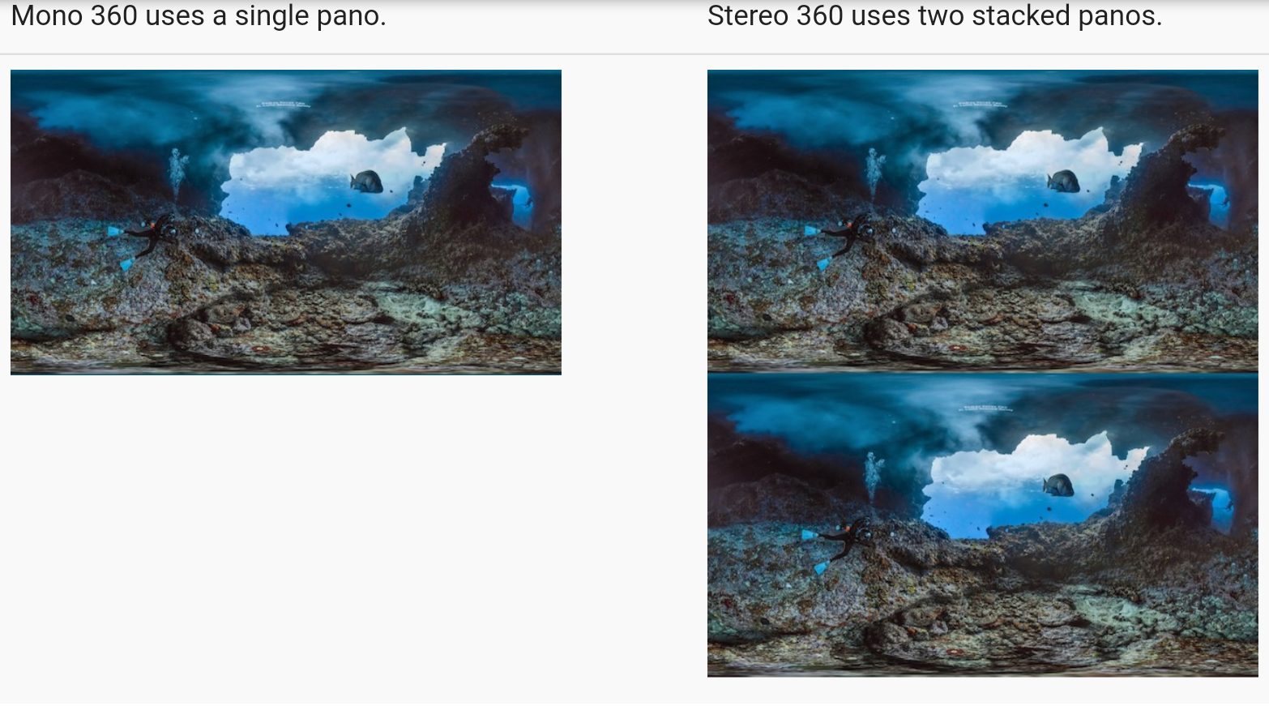
omnidirectional stereoscopic content
omnidiretional monoscopic content
nearby objects have greater disparity
→ adding depth between fore- & background → immersive
better resolution (twice of stereo)
(4)
(5)

Slide 7
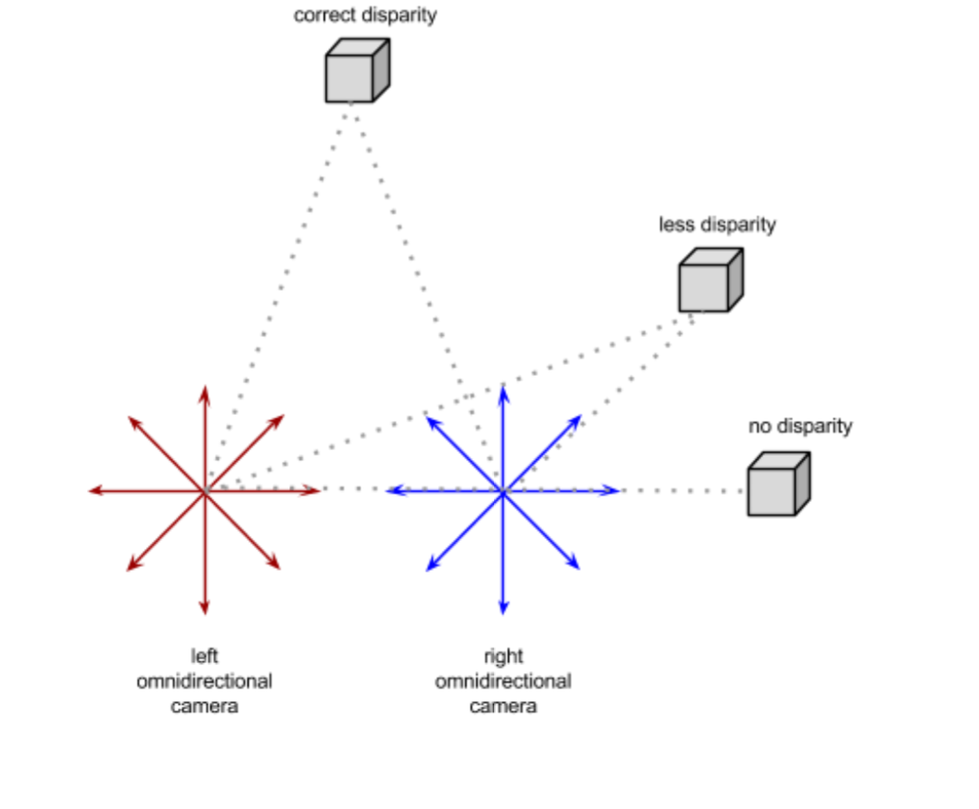
Videos for VR View
format: mp4 encoded with h264 or
adaptive streaming manifest file:mpd, m3u8
resolution: mono, 2:1 ratio, 1920x1080
stereo, 1:1 ratio, 2048x2048
stereo video: 2 cameras/videostreams → interpupillary distance → problems
→ for best results: controlled & static
(5)

Slide 8
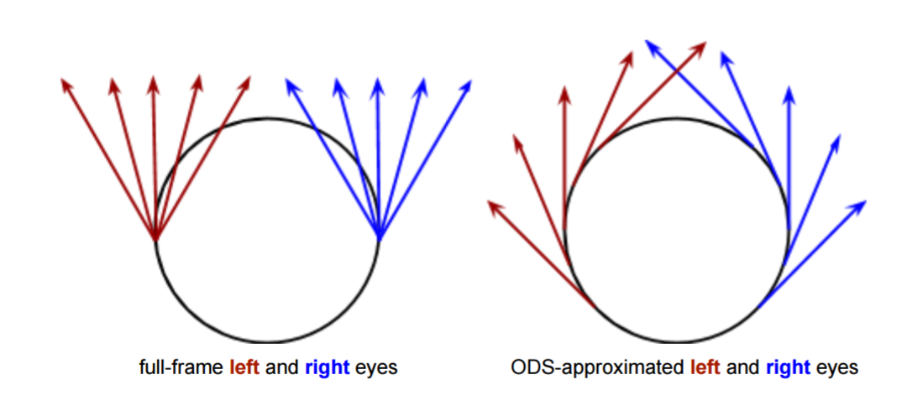
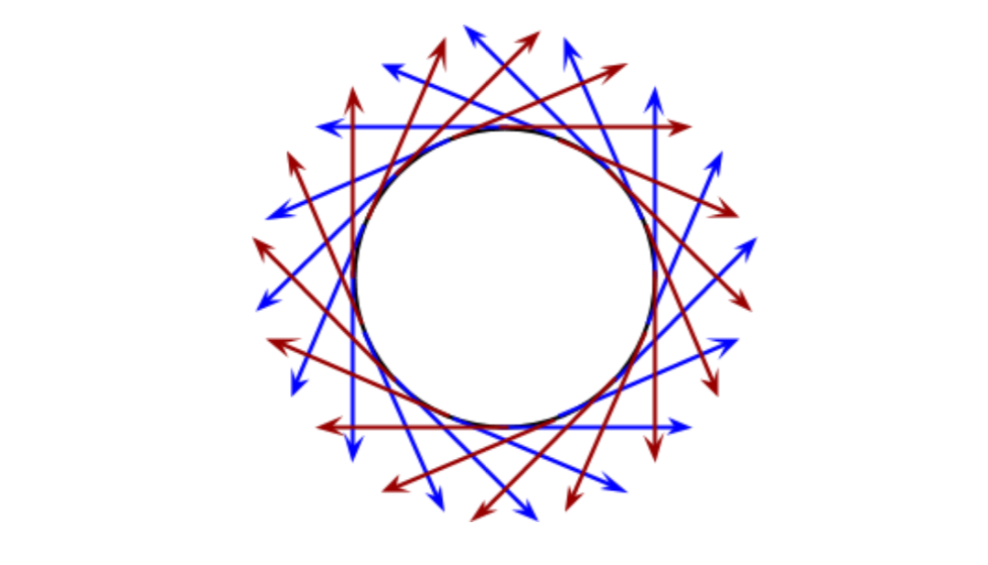
360° omnidirectional picture
(5)

Slide 9
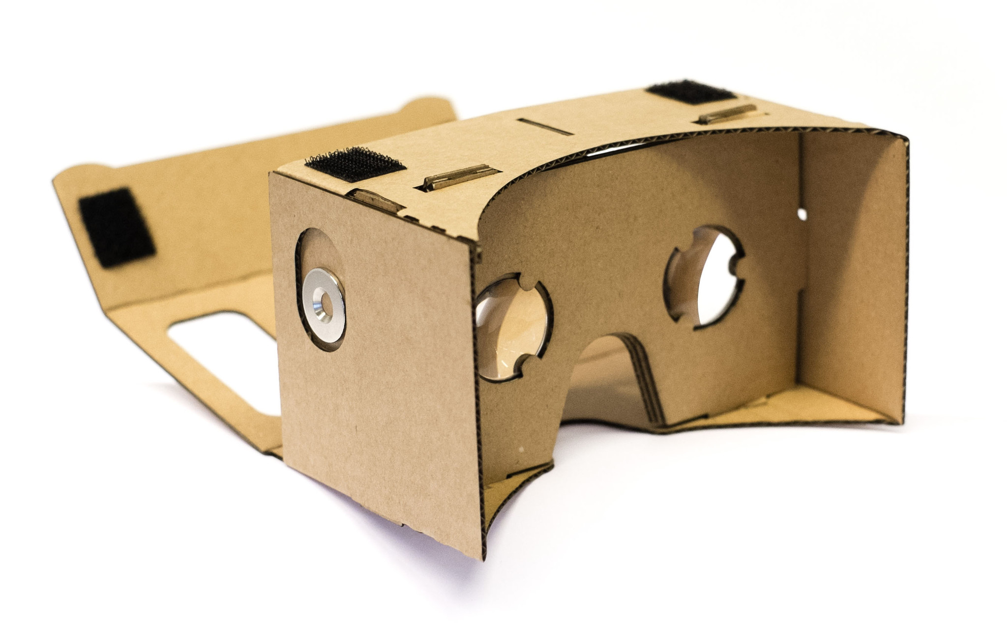
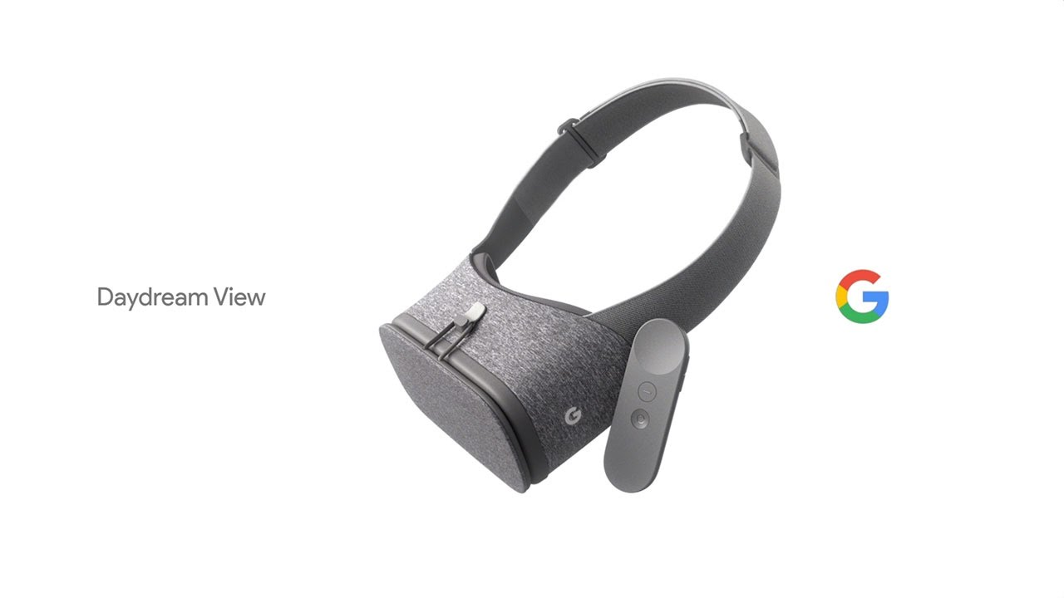
Devices made for VR View
Google Cardboard/Daydream
12 million cardboard sales expected 2016
advantages: cheap, no cables/extra room, portabilty
→ easy access → many users
disadvantages: limited hardware
→ VR View is made for sharing moments
(6)
(7)

Slide 10
Sources
https://d28m5bx785ox17.cloudfront.net/v1/img/HigQ5QcpO7z63P8I7zeZZ8D7BWNT5WHPF2SlHR5mIDE=/w/4096
https://upload.wikimedia.org/wikipedia/commons/thumb/8/83/Tissot_indicatrix_world_map_equirectangular_proj.svg/2000px-Tissot_indicatrix_world_map_equirectangular_proj.svg.png
http://www.roadtovr.com/wp-content/uploads/2015/05/gopro-jump-rig.jpg
https://developers.google.com/vr/concepts/vrview
https://developers.google.com/vr/jump/rendering-ods-content.pdf
http://virtual.ingame.de/files/2016/02/google_cardboard_2.jpg
https://i.ytimg.com/vi/rLLAA4ENIP4/hq720.jpg

